Slide 1

A Hands-on Introduction to Machine Learning
5. Classification-1

Slide 2
What is supervised learning?
Learning from data when we have correct labels / outcome values
Example: Predicting whether it will rain tomorrow (yes/no) based on patterns in atmospheric data like humidity, temperature, and pressure.
A major areas: regression and classification

Slide 3
What we will cover
kNN
Decision tree
Random forest

Slide 4
kNN (k nearest neighbor)
As in the general problem of classification, we have a set of data points for which we know the correct class labels.
When we get a new data point, we compare it to each of our existing data points and find similarity.
Take the most similar k data points (k nearest neighbors).
From these k data points, take the majority vote of their labels. The winning label is the label/class of the new data point.

Slide 5
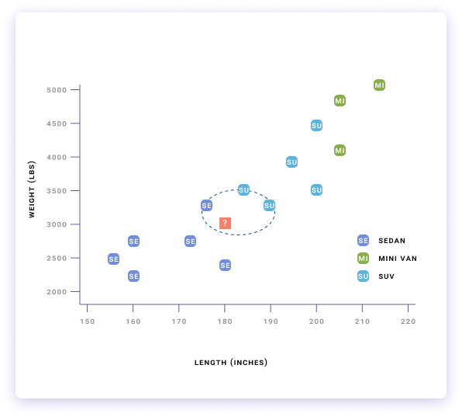
Working through kNN

Slide 6
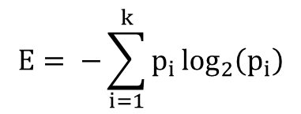
Decision tree: Entropy and information gain
$$E= −\sum_{i=1}^{k}{p_{i}\log_{2}\left(p_{i}\right)}$$
Notes:
Entropy is a measure of disorder, uncertainty, or randomness. If I toss a fair coin there is an equal chance of getting a head or a tail. In other words, we would be very uncertain about the outcome, so we would have high entropy. The formula of entropy is:
Information gain: If you thought it was not going to rain today and I tell you it will indeed rain, you have gained some information. On the other hand, if you already knew it was going to rain, then my prediction will not really impact your existing knowledge much. There is a mathematical way to measure such information gain:
The information gain achieved by knowing B along with A is the difference between the entropy (uncertainty) of A and the entropy of A conditional on B.

Slide 7
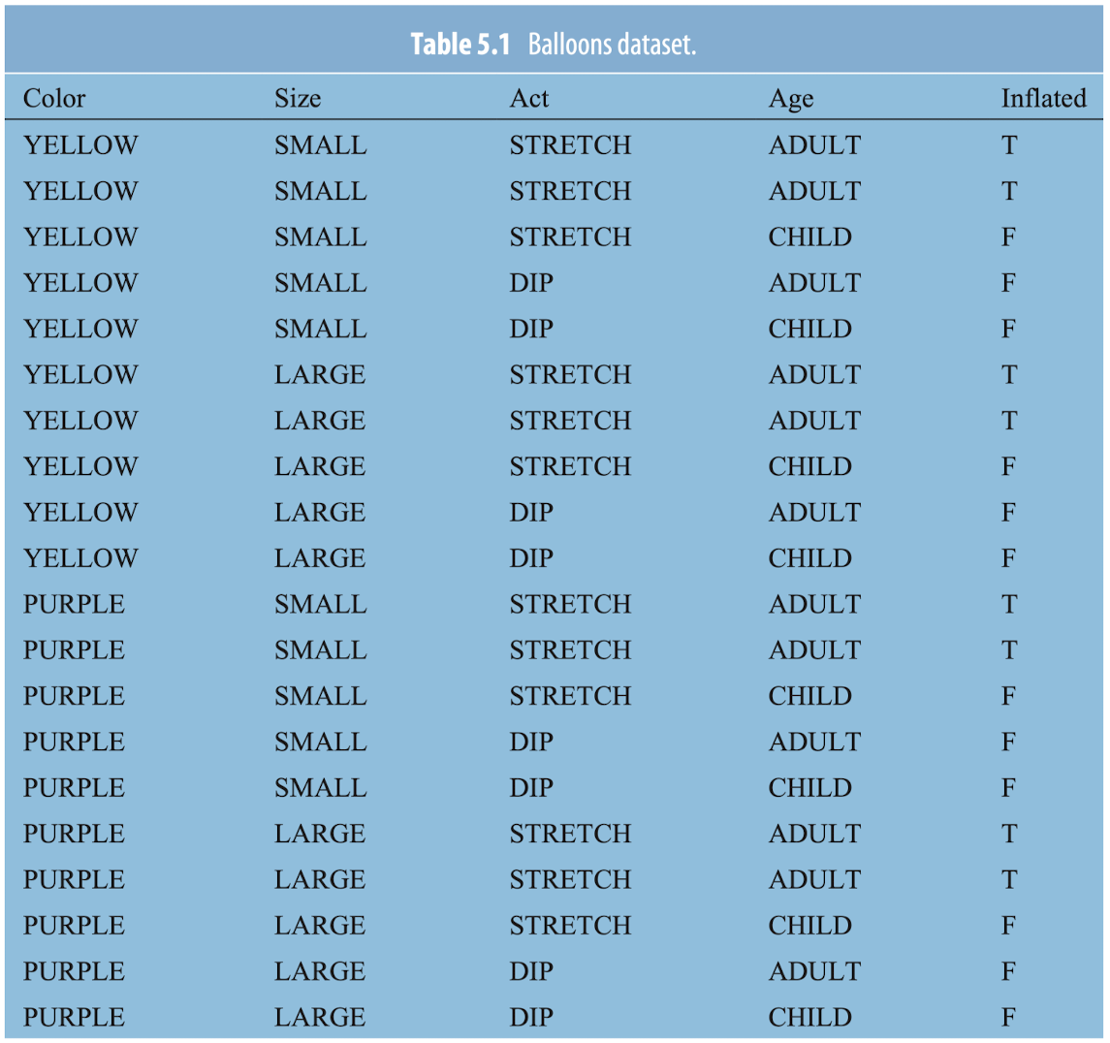
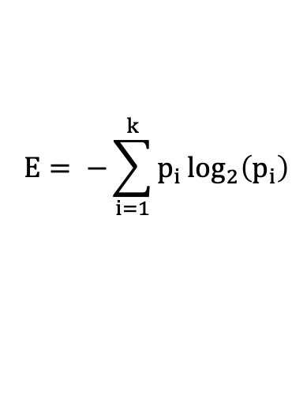
Decision tree: Example Entropy
$$E= −\sum_{i=1}^{k}{p_{i}\log_{2}\left(p_{i}\right)}$$
Notes:
Entropy is a measure of disorder, uncertainty, or randomness. If I toss a fair coin there is an equal chance of getting a head or a tail. In other words, we would be very uncertain about the outcome, so we would have high entropy. The formula of entropy is:
Here, k is the number of possible class values and pi is the number of occurrences of the class i = 1 in the dataset. In the “balloons” dataset the number of possible class values is 2 (True or False). The reason for the minus signs is that logarithms of the fractions p1, p2, …, pn are negative, so the entropy is actually positive. Usually the logarithms are expressed in base 2, and then the entropy is in units called bits.

Slide 8
Decision tree
Step 1: Calculate Entropy of the target or class variable
Step 2: The dataset is then split on the different attributes into smaller sub-tables. The entropy for each sub-table is calculated. Then it is added proportionally, to get total entropy for the split. The resulting entropy is subtracted from the entropy before the split. The result is the Information Gain or decrease in entropy.
Step 3: Choose attribute with the largest information gain as the decision node, divide the dataset by its branches and repeat the same process on every branch.

Slide 9
Decision tree example
Outlook
Sunny
Overcast
Rainy
Windy
P = Y
Humidity
False
True
High
Normal
P = Y
P = N
P = N
P = Y

Slide 10
Decision tree rules
Decision rules: they can be within (or derived by) a decision tree to dictate the splitting of data at each node based on specific feature values, leading to a particular outcome or decision.
Classification rules: they refer to the set of criteria derived from the decision tree that systematically assign data points to predefined categories or classes based on their attributes.
Association rules: they highlight and model the correlations and connections between different data attributes, revealing how the presence or value of one or more attributes affects the occurrence of another attribute within the dataset.

Slide 11
Random forest
Problem with decision tree: could overfit the data, making it difficult to do well on new data
A solution: grow many decision trees that are randomly paralyzed, and have them vote for an outcome = random forest
It combines the predictions from multiple decision trees to make more accurate and stable predictions than any single tree could on its own. It's like asking a group of experts for their opinions and then taking the majority vote as the final decision.

Slide 12
Summary
Supervised learning algorithms use a set of examples from previous records that are labeled to make predictions about future.
Two main branches: regression and classification
Classification techniques:
kNN
Decision tree
Random forest

